Slide 1

The Fair Labor Standards Act:
What and Who is Covered?
Doug Desmarais, Esq.
(410) 321-9348
ddesmarais@smithdowney.com

Slide 2
Note that this presentation is intended as a general discussion of the law and is not intended as legal advice for any particular situation.

Slide 3
Overview
Fair Labor Standards Act
  Independent Contractors vs. Employees
  Joint Employment
  Special Cases – Volunteer and Trainees
  Exempt v. Non-Exempt Employees
  Challenging Cases
Equal Pay Act

Slide 4

Fair Labor Standards Act
Establishes standards for:
  Minimum wages
  Overtime pay
  Wage deductions
  Child labor
  Calculation of hours worked
  Recordkeeping
  Anti-retaliation
Generally requires employers to pay 1 ½ times the employee’s regular rate of pay for all hours worked in excess of 40 hours per week

Slide 5

Employees vs. Independent Contractors: Definitions
Employee: An individual employed by an employer and who, as a matter of economic reality, is dependent on the business that they serve. 29 U.S.C. § 203(e).
Employer: Any person acting directly or indirectly in the interest of an employer in relation to an employee.
Independent Contractor: One who performs a service for a business, but is not in an employment relationship with the business.

Slide 6

Employees vs. Independent Contractors: Economic Realities Test
Consider the following factors:
  Degree of control
  Investment in facilities
  Opportunity for profit and loss
  Permanency of relationship
  Required skill

Slide 7

Special Cases: Trainees/Interns
Not employees if training/internship is:
Similar to training in educational environment
Primarily for benefit of intern
Doesn’t displace regular employee
Trainee works under supervision of regular staff
No immediate advantage to employer
Mutual understanding that trainee is not entitled to compensation
No guarantee of a future job

Slide 8
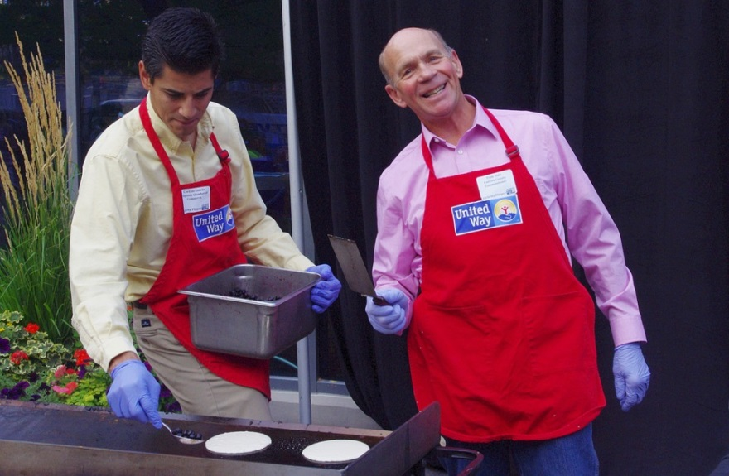
Special Cases: Volunteers
Individuals can volunteer services to non-profit, religious, or charitable organizations
Relevant factors:
  Who receives greater benefit from the work
  Whether work is integral to the business
  Presence of coercion
  Whether activity occurs during normal work hours
  Similarity between volunteer activities and regular job duties
  Length of relationship
  Number of hours spent volunteering

Slide 9
The “White Collar” Exemptions from Overtime
Must meet BOTH the Salary Basis Test and the Duties Test
  Salary Basis Test: Under current standard, must be paid at least $455 on a salary basis. No deductions for quality or quantity of the employee’s work.
  Duties Test:
    Administrative
    Professional
    Outside Sales
    Computer Professional
    Executive
    Highly Compensated

Slide 10
Highly Compensated Employees
Employee currently must be paid at least $100,000 per year total annual compensation
Employee currently must be paid on a salary basis of at least $455 per week
Must “customarily and regularly” perform at least one of the duties of an exempt executive, administrative, or professional employee

Slide 11
Salary Basis Test - Overview
Under the salary basis test, the employee must be paid a salary that meets the minimum required by the DOL, and the employer cannot deduct from the employee’s weekly salary, unless authorized by the DOL or FMLA.
Currently, the salary minimum is $455/week, but the new DOL final overtime rule will raise the salary minimum for the white collar exception.

Slide 12
Final Changes to White Collar Exemptions
On September 24, 2019, the DOL issued its final overtime rule.
Effective January 1, 2020, Changes to Salary Basis Test Minimum Levels:
  New salary minimum increases to $684 per week ($35,568 per year); and
  New minimum for highly compensated employees increases to $107,432 per year

Slide 13
Nondiscretionary Bonuses &
Incentive Payments - Overview
The new rule permits employers to use nondiscretionary bonuses and incentive payments to satisfy up to 10 percent of the standard salary level.
For employers to credit nondiscretionary bonuses and incentive payments toward a portion of the standard salary level test, they must make such payments on an annual or more frequent basis.

Slide 14
Nondiscretionary Bonuses &
Incentive Payments – Catch Up
If an employee does not earn enough in nondiscretionary bonus or incentive payments in a given year (52-week period) to retain his or her exempt status, the Department permits the employer to make a “catch-up” payment within one pay period of the end of the 52-week period.
This payment may be up to 10 percent of the total standard salary level for the preceding 52-week period. Any such catch-up payment will count only toward the prior year’s salary amount and not toward the salary amount in the year in which it is paid.

Slide 15
Salary Basis Test:
Allowable Deductions
FLSA only allows for specific deductions from salary of exempt employees:
  Absence of 1 or more full days for personal reasons other than sickness or disability
  Absence 1 or more full days for sickness or disability if in accordance with bona fide policy
  Jury fees, witness fees, military pay
  Penalties imposed in good faith for infraction of safety rule of major significance
  Unpaid disciplinary exemption 1 or more full days imposed in good faith for infraction of workplace conduct rule
  Proportional payment initial or terminal week of employment
  Weeks in which employee takes unpaid leave under FMLA

Slide 16
The “White Collar” Exemptions from Overtime
Must meet BOTH the Salary Basis Test and the Duties Test
  Salary Basis Test: Under current standard, must be paid at least $455 on a salary basis. No deductions for quality or quantity of the employee’s work.
  Duties Test:
    Administrative
    Professional
    Outside Sales
    Computer Professional
    Executive
    Highly Compensated

Slide 17

Administrative Exemption Duties
Primary duty is the performance of office or non-manual work directly related to the management or general business operations of the employer or the employer’s customers
Primary duty must include the exercise of discretion and independent judgment with respect to matters of significance

Slide 18

Executive Duties
Primary duty must include:
  Managing the enterprise, or managing a customarily recognized department or subdivision of the enterprise;
  Customarily and regularly direct the work of at least 2 or more full-time employees or their equivalent; and
  Authority to hire or fire other employees, or suggestions and recommendations as to the hiring, firing, advancement, promotion or any other change of status of other employees must be given particular weight.

Slide 19


Professional Exemption Duties
“Learned” Professional
“Creative” Professional
Work requires advanced knowledge in a field of science or learning, which is customarily acquired by a prolonged course of specialized intellectual instruction
Work requires invention, imagination, originality, or talent in a recognized field of artistic or creative endeavor

Slide 20

Computer Professional Exemption Duties
Primary duty must include:
  The application of systems analysis techniques and procedures;
  The design, development, documentation, analysis, creation, testing or modification of computer systems or programs; or
  A combination of the preceding duties, the performance of which requires the same level of skill

Slide 21

Outside Sales Exemption Duties
Primary duty is making sales or obtaining orders or contracts for services or for the use of facilities for which a consideration will be paid by the client or customer
Employee must be “customarily and regularly engaged away” from the employer’s place of business.
No Salary Requirement!

Slide 22

Nonexempt Employees: Compensable Time
General Rule:
  “Suffer or permit to work”
Special Cases
  Waiting Time
  Rest Periods
  Meal Periods
  Prep Time and Concluding Activities
  Meetings and Trainings
  Travel Time

Slide 23
Nonexempt Employees: Waiting Time
“This is a 9-5 job that is spaced out over the course of the day.”
- Lady Gaga
Factors:
  Requirement to live on premises
  Excessive geographic restrictions on employee movement
  Frequency of calls
  Fixed time limit to respond to a call
  Whether trading of on-call responsibilities is permitted
  Whether employee can be reached by pager or cell phone
  Whether employee actually engaged in personal activities during the on-call time.

Slide 24

Nonexempt Employees:
Rest and Meal Periods
Rest Periods
  Rests of short duration should be counted as hours worked
  Longer breaks need not be counted if the employee is relieved of all cuties
Meal Periods
  “Bona fide” meal period not compensable, provided employee not required to perform any services
  “Bona fide” meal period usually 30 minutes or more

Slide 25

Best Practices for
Avoiding FLSA Liability
Dealing with New Technology and Off-the-Clock Work
Importance of Job Descriptions
  Updated?
  Actually describe what the employee does?

Slide 26

FLSA Safe Harbor
Improperly docking exempt employees’ pay may jeopardize exempt status.
Exemption is not lost if an employer:
  Has a clearly communicated policy prohibiting improper deductions, and includes complaint mechanism;
  Reimburses employees for improper deductions; and
  Makes good-faith commitment to comply in future.
This Photo is licensed under CC BY-SA

Slide 27

FLSA Safe Harbor (cont.)
Should Include:
  Statement of Policy and Practice to accurately compensate employees;
  Statement of Purpose;
  Statement of Responsibility;
  Prohibition of off-the-clock work;
  Confirmation that company will promptly correct mistakes brought to its attention; and
  Reporting Procedures.
This Photo is licensed under CC BY-SA-NC

Slide 28
QUESTIONS?
THANK YOU!

