Slide 1
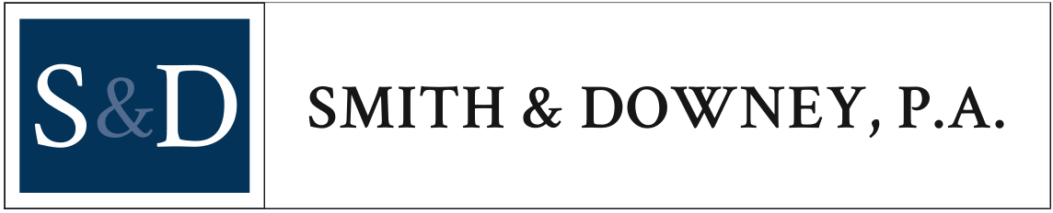
RECENT DEVELOPMENTS IN
EMPLOYEE BENEFITS
Susan S. Risinger

Slide 2
this PRESENTATION IS merely a summary of some recent developments and should not be relied upon as legal advice for any particular situation.

Slide 3
I. IRS Expands Determination Letter Program
Cash balance plans (and other statutory hybrid formulas) are permitted to apply for a determination letter from September 1, 2019 – August 31, 2020. The policy rationale for this expansion is to ensure plans are fully compliant with recently-issued final regulations impacting such plans.
“Merged plans” are permitted to apply beginning September 1, 2019, if certain requirements are met.
TAKE-AWAY: Employers with cash balance plans or recently merged plans should take advantage of these limited windows to ensure compliance.

Slide 4
II. SECURE Act
Key Provisions. Among other items, the Act generally:
Makes it easier to run multiple-employer plans.
Allows greater access to part-time employees.
Incentivizes enrollment in 401(k) plans by adding new tax credits of $500 to encourage small employers to automatically enroll employees in retirement plans.
Requires all defined contribution plans to include a lifetime income disclosure on a yearly basis that shows how much income the lump sum balance in their retirement account would create.

Slide 5
Delays the required minimum distribution (RMD) age from 70.5 to 72. (Note that the Senate’s version of this law – known as RESA – would push this back to age 75.)
Removes the age limit that disallowed contributions to IRAs after age 70.5.
Eliminates the early withdrawal penalty for individuals using retirement funds to cover the cost of birth or adoption
TIP: If we have learned anything over the past decade or more of governmental disfunction, it is that employers should “wait and see”. This Act is currently stalled in the Senate, and despite seemingly widespread bipartisan support, it is bound to have many forms.

Slide 6
III. Student Loan Repayments and 401(k) Plan
TAKE-AWAYS:
Guidance is in a “private letter ruling” which is limited to the facts of the individual taxpayer and its plan design, and the current proposed legislation is uncertain.
Prototype documents and testing concerns.
The prevailing thought is that the legislation will need to be passed and regulatory guidance issued before employers can comfortably introduce this design, although employers that want to aggressively pursue this option immediately have some guidance available.

Slide 7
IV. Uncashed Checks Under Retirement Plans
Problem: Participant never cashes a distribution check - participant chooses to not cash the check, sends the check back to the Plan, destroys the check, or cashes the check in a subsequent year.
Question by Employers: How/When do we report this distribution?
TAKE-AWAY: Continue doing what you should already be doing – follow plan terms for distributions, withhold taxes, and report distributions in the year made.

Slide 8
V. “Multiple Employer” Arrangements
DOL final rule: A “commonality of interest” needed to establish an “association retirement plan” is satisfied if the employer members of the group or association either (1) are in the same trade, industry, line of business or profession, or (2) have a principal place of business in the same region that does not exceed the boundaries of a single state or a metropolitan area (even if the metropolitan area includes more than one state).
IRS proposed rule: Provides exceptions to the “one bad apple” rule (solely for defined contribution plans). Under certain conditions and for certain types of failures, the proposed rule would eventually allow a plan – after several remedial steps – to avoid full plan disqualification by allowing for a spinoff of assets attributable to participants to a separate plan and a termination of that plan where the participants are employed by a participating employer that is unable or unwilling to correct a qualification failure.
TIP: Be sure to obtain proper counsel before entering a MEP.

Slide 9
VI. Recent Changes to EPCRS
  Self Correction Program now available for
  Plan loan failures
  Retroactive plan amendments to conform plan terms to plan operations
TIP: Employers should take advantage of these new opportunities to ensure compliance.

Slide 10
VII. 401(k) Final Regulations: Hardships
Personal “Casualty Loss” Expenses – No need to be attributable to federally declared disaster (Optional 2018/2019; Mandatory 2020)
New Distribution Event: Expenses (including loss of income) incurred as a result of a Federally declared disaster that occurs near the employee’s home or work (Optional beginning 2019)
“Plan loans first” requirement (Optional beginning 2019)
Eliminate required suspension of elective deferrals after an individual takes a hardship distribution. (A Section 409A plan may retain its suspension provisions.) (Optional 2019; Mandatory 2020)
“Necessary to satisfy an immediate and heavy financial need” changes (Optional 2019; Mandatory 2020)
Elective contributions, QNECs, QMACs and earnings on the same (401(k) Plans only). (Optional 2019)
TIP: Check with your TPA to ensure all plan amendments, SMMs and election/certification forms are updated and adopted timely.

Slide 11
VIII. DOL Proposed Regulations: Electronic Delivery
Would permit retirement plan sponsors to make plan disclosures available online.
Would offer a safe harbor for those sponsors that want to make electronic retirement plan disclosures the default. Participants would be notified that information is available online, including instructions for how to access the disclosures and their right to receive paper copies of disclosures.
Includes additional protections for participants, such as standards for the websites where disclosures will be posted and system checks for invalid electronic addresses.
CURRENT LAW CONTINUES TO APPLY
TIP: Employers should “wait and see”.

Slide 12
ix. Update on ERISA Litigation
Investment options and fees
Statute of limitations
Arbitration
TIP: Important to keep an eye on ERISA litigation, as much as legislation, because real money can be lost in court.

Slide 13
X. IRS UPDATED ANNUAL LIMITS
Highlights of changes for 2020:
The contribution limit for employees who participate in 401(k), 403(b), most 457 plans, and the federal government's Thrift Savings Plan is increased from $19,000 to $19,500.
The catch-up contribution limit for employees aged 50 and over who participate in these plans is increased from $6,000 to $6,500.
The limitation regarding SIMPLE retirement accounts for 2020 is increased to $13,500, up from $13,000 for 2019.
The annual compensation limit increased from $280,000 to $285,000.
The limitation used in the definition of “highly compensated employee” under §414(q)(1)(B) is increased from $125,000 to $130,000.
See IRS Notice 2019-59 for the full list of changes.

Slide 14
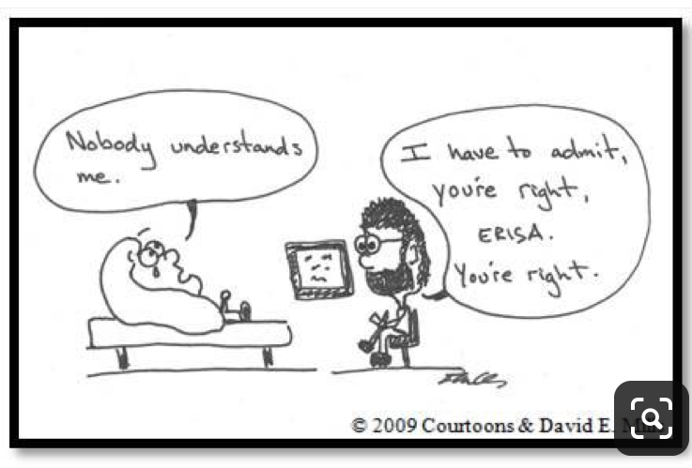

Slide 15
THANK YOU!!

Slide 16

Questions?
  Susan S. Risinger
  (843) 553-4716
  srisinger@smithdowney.com
  www.smithdowney.com
This Photo by Unknown Author is licensed under CC BY-NC-ND
This Photo by Unknown Author is licensed under CC BY-NC-ND

